Slide 1
Temporal Analysis of Dynamic Collaboration Graphs of Open Source Software Development
Preliminary Exam Proposal
Amir Azarbakht
Notes:
My name is Amir, one of the authors of this study,
It’s about HOW and WHY older adults are active in open source.
<number>

Slide 2
Related Work, cont.
Research on forking exists
However, it's mostly post-hoc
What was the outcome
What was the cause
What we don't know about forking? (a number of unanswered questions)
Very little looking at the run-up
Predictability
Was it a long-run trend? or
Community polarized
Tipping point
We're missing that context (pre-), what we have now, is post-hoc
Finding better measures for influence, and the shift of influence
<number>

Slide 3
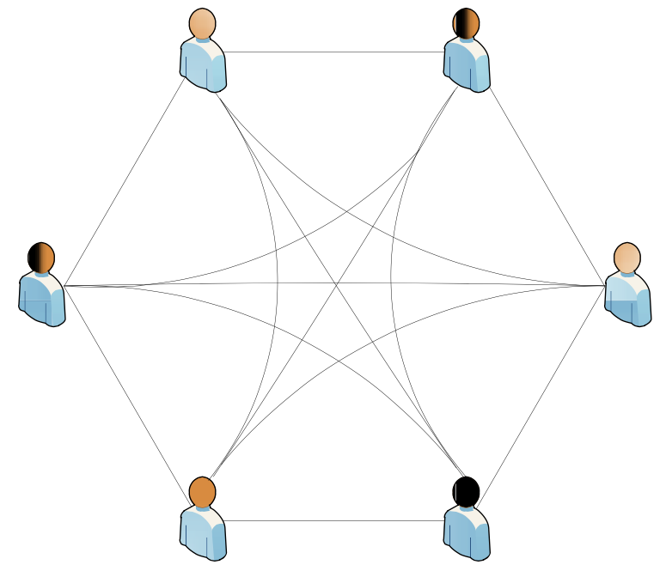
Introduction
Social networks are a ubiquitous part of our social lives.
There are many open questions about the social dynamics in FOSS communities; especially about forking.
Most recent studies of FOSS communities have tended to suffer from an important limitation; They treat community as a static structure rather than a dynamic process.
<number>

Slide 4
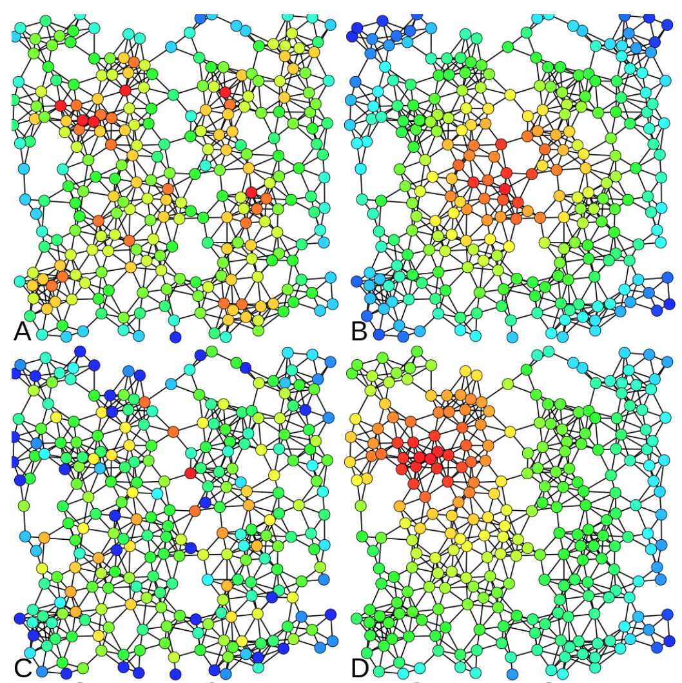
Related Work
FOSS communities have been studied extensively.
The study of communities has grown in popularity in part thanks to advances in social network analysis.
<number>

Slide 5
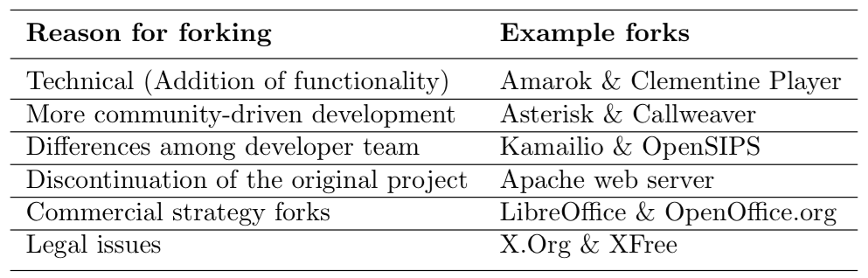
Related Work
Community splits in FOSS are referred to as forks. Forking is defined as ...
The main reasons for forking ...
<number>

Slide 6
Related Work, cont.
The dynamic behavior of a network and identifying key events was the aim of a study [Asur et al.] ...
The communication patterns of FOSS developers in a bug repository were examined [Howison et al.] ...
The tension between diversity and homogeneity in a community was studied [Kunegis et al.] ...
Community dynamics was the focus of a recent study [Hannemann and Klamma] on three open source bioinformatics communities.
Most studies on FOSS have only been carried out on a small number of projects, and using snapshots in time. No study on the temporal dimension.
<number>

Slide 7
Related Work, cont.
Research on forking exists
However, it's mostly post-hoc
What was the outcome
What was the cause
What we don't know about forking? (a number of unanswered questions)
Very little looking at the run-up
Predictability
Was it a long-run trend? or
Community polarized
Tipping point
We're missing that context (pre-), what we have now, is post-hoc
Finding better measures for influence, and the shift of influence
<number>

Slide 8
Motivation
To better understand and measure the evolution, social dynamics of FOSS projects, and integral components to understanding their evolution and direction, we need new and better tools.
This is important because projects fork all the time.
Managing growing pains is especially important in case of FOSS.
Recipes for success or stagnation, sustainability or fragmentation could be identifiable, leading to a set of best practices and pitfalls.
<number>

Slide 9
Research Goals and Methods
Social interactions data reflects the changes the community goes through, and is able to describe the context.
Three of the six reasons for forking are socially related.
We aim to analyze, quantify and visualize how the community is structured, how it evolves, and the degree to which community involvement changes over time.
<number>
Notes:
<number>

Slide 10
Research Objective 1: Exploring the usefulness of social interactions data and its relationship to social dynamics within a forked FOSS project.
R.Q. 1.1. Does the social interactions data represent the social dynamics of the development community? How well? (e.g. for an outsider; a person without insider knowledge of history and status que)
What are the perceived benefits of carving out and showing social interactions data to the project stakeholders? (e.g. project devs, users, sponsor organizations, potential investors)
R.Q. 1.2. Are “Personal differences” and “technical differences” forking reasons associated with distinctly different interaction patterns?
<number>

Slide 11
Research Objective 1: What are the social patterns associated with different types of forking?
R.Q. 1.1.1 Is there a prototypical fork for “personal differences” reason for forking?
R.Q. 1.1.2 Is there a prototypical fork for “more community-driven development” reason for forking?
R.Q. 1.1.3 Is a labeled project as a “technical differences” fork really only a “technical differences” fork?
R.Q. 1.1.4 Are there patterns that exemplify these categories?
R.Q. 1.1.5 What are the determining factors?
R.Q. 1.1.6 Where are the determining factors? In Mailing List data? In Code?
R.Q. 1.1.7 What do the determining factor look like?
<number>

Slide 12
Research Objective 2: Temporal Evolution Analysis
R.Q. 2.1. Is it possible to tell the difference between when the reason for forking was personal vs. technical?
R.Q. 2.2. What establishes an inflection point [fork]? Which metrics are indicative of inflection?
R.Q. 2.3. Undoable to prove! What change in metrics can be used as the indicator? (Threshold = ?) Undoable to prove and check after finding and hypothesis. Because no possible examples of inevitable not-forking projects that have flirted with disaster
<number>

Slide 13
Research Objective 3: Actionable Visualization
R.Q. 3.1. Is it possible to tell between when the reason for forking is “more community-driven development” and “differences among the developer team” through a visual representation of collaboration patterns?
R.Q. 3.2. What are the perceived benefits and risks of making the social interactions visual representation to the development community, and project stakeholders?
<number>

Slide 14
Research Objective 3: Actionable Visualization
R.Q. 3.1.1 Does my analysis of the situation match what people in that community remember?
R.Q. 3.1.2 If I show someone, would they draw the same conclusion as the first one?
Current community folks, have them reflect on … and future (less important than RQ1)
Can we use these to know HOW and WHY projects fork?
<number>

Slide 15
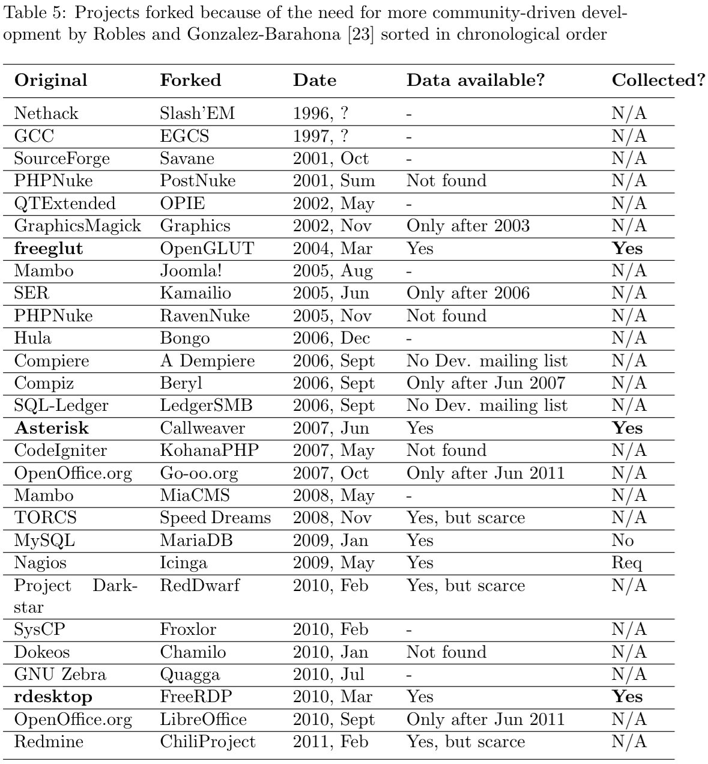
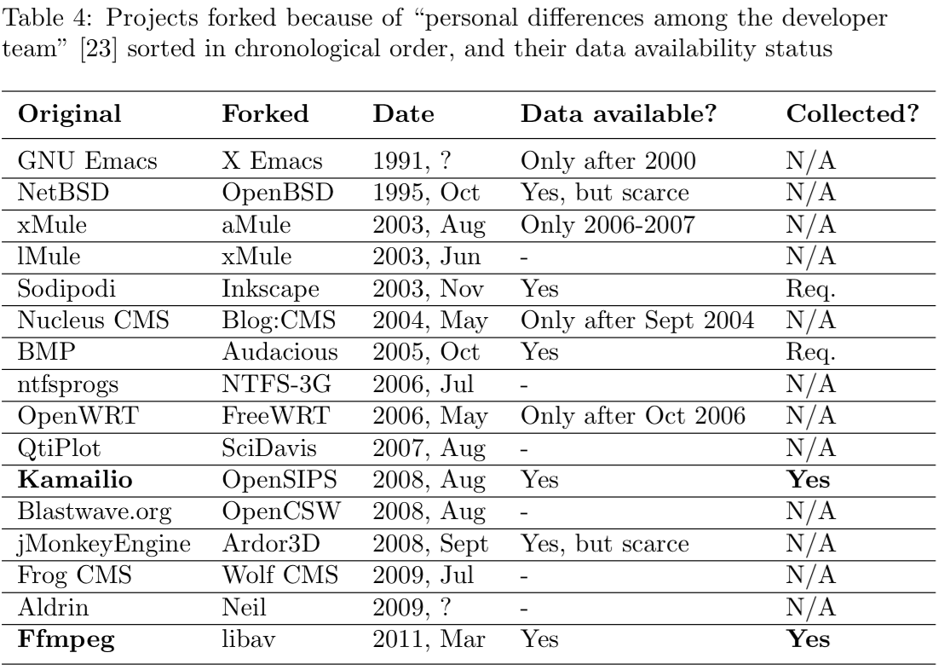
Methodology: Data Gathering
<number>

Slide 16
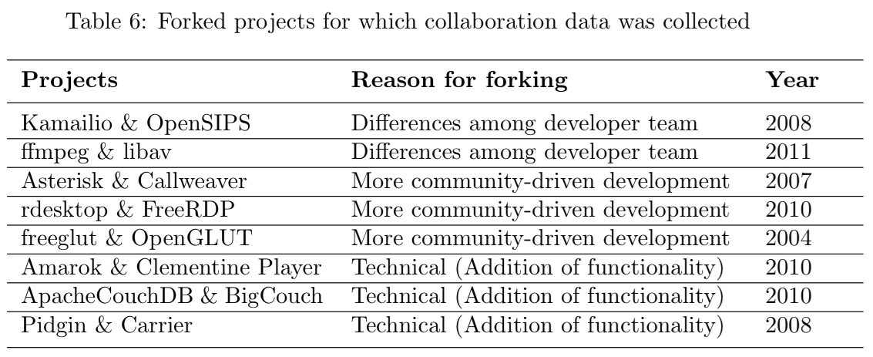
Collected Data
<number>

Slide 17
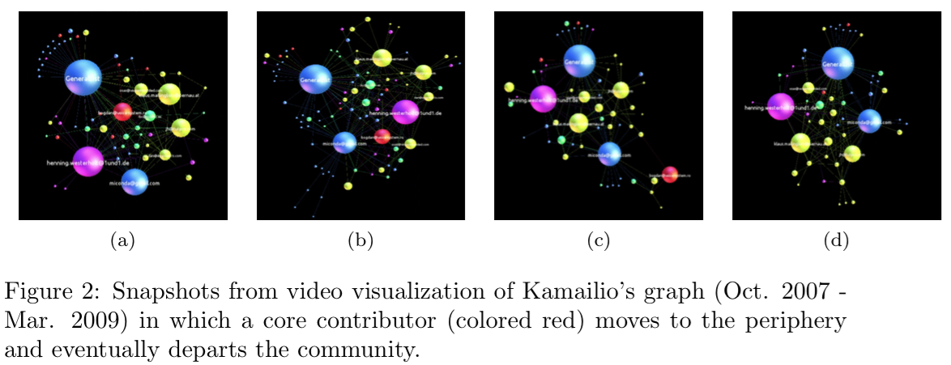
Visualization #1
<number>

Slide 18
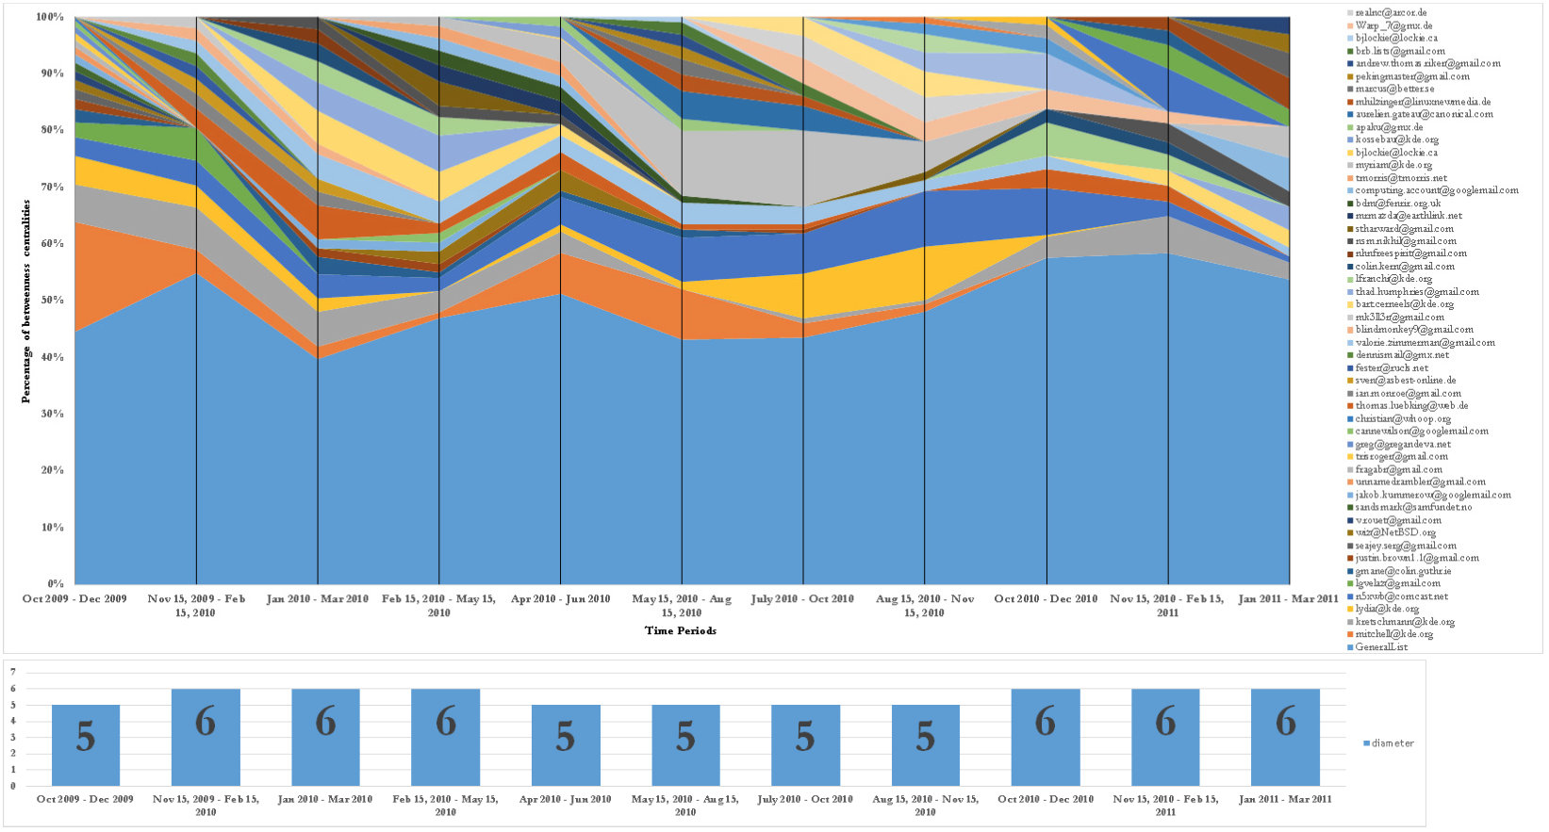
Influence Analysis
<number>

Slide 19
To Do
Statistical analysis of sparsely-labeled data
Regression <?>
Semi-supervised learning
Label propagation method
Visualization
Lab study and interviews with stakeholders
<number>

Slide 20
Thanks
<number>
Notes:
<number>

Slide 21
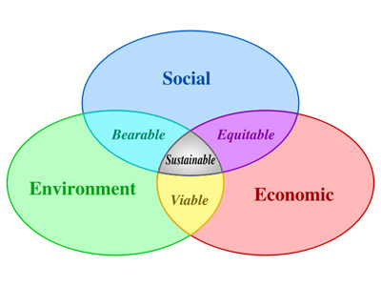
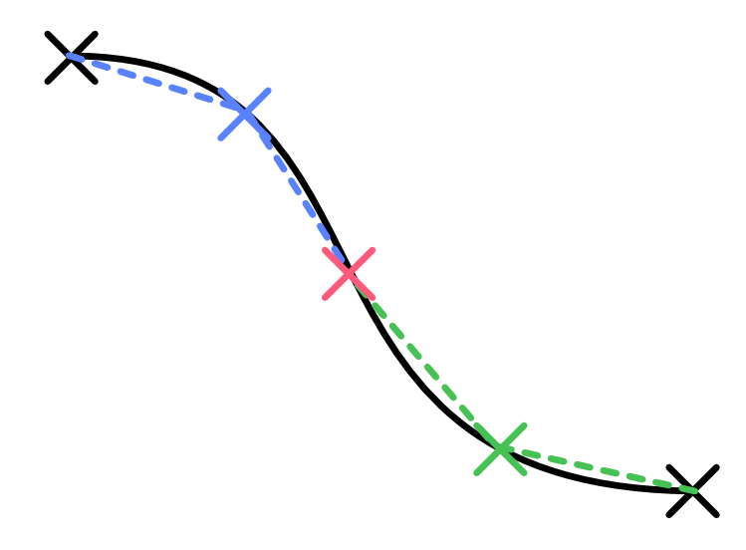
Success
How to measure?
What attributes => success
Sustainability
How long can be sustained
Inflection points
What events/conditions => inflection
<number>
3/31/15

Slide 22
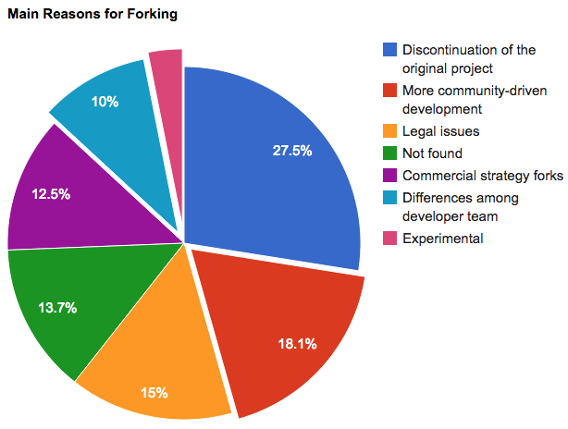
Reasons for forking
<number>

Slide 23
Main Reasons for forking
[Robles and Gonzalez-Barahona 2012]
<number>
3/31/15

